Slide 1
New Hampshire Business Products
Current Business Operations
Candace Ralston
Notes:
Hi everyone, this presentation is for the company New Hampshire business products. They wish for us to help them out with expanding their business.

Slide 2
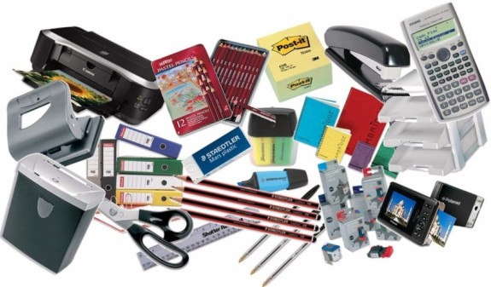

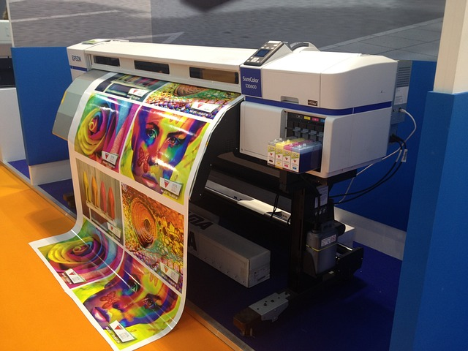
New Hampshire Business Products: Background Information
office supplies
office equipment
printing services
This Photo by Unknown Author is licensed under CC BY-SA-NC
Notes:
NHBP is a small company operating as a sole proprietorship desiring to expand its geographical reach. The products sold by NHBP fall into three categories: office supplies, office equipment, and printing services.

Slide 3
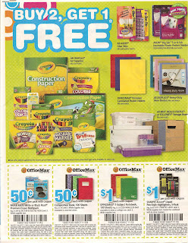
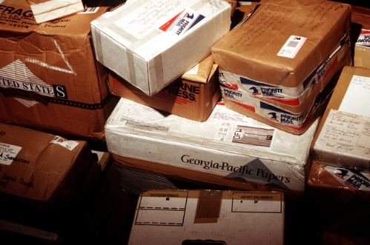
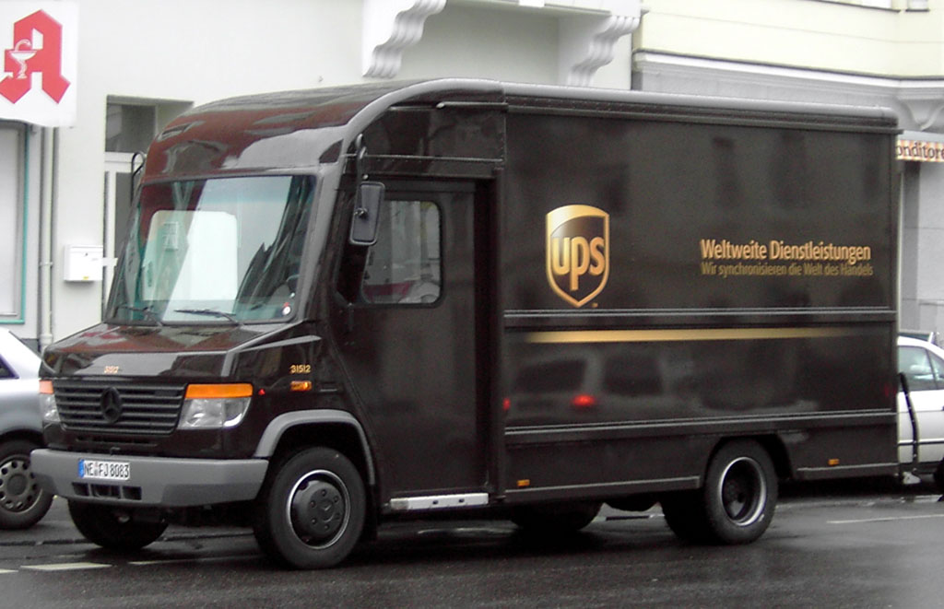
New Hampshire Business Products: Background Information
Opened in 2005
Convenient location
Online/Hard Catalog
24/7 Delivery
This Photo by Unknown Author is licensed under CC BY
This Photo by Unknown Author is licensed under CC BY-SA
Notes:
The company opened in 2005 and has one brick-and-mortar location. They have a catalog with all of their products and services. As well as they deliver with their own trucks and use other delivery services like UPS.

Slide 4
New Hampshire Business Products: Total Current Sales
Notes:
Here is the current sales for all of the products and services. The office equipment, office supplies, and the printing services.

Slide 5
New Hampshire Business Products: Projected Sales
Notes:
This is the projected sales for 5 years. Beginning from 2023-2028, we have a projected growth of 20% of all sales of products and services.

Slide 6
New Hampshire Business Products: Desired Sales Growth
Notes:
This is the desired sales growth for products and services. The sales growth is from 2023 to 2038.

Slide 7

New Hampshire Business Products: Stated Business Needs
Increase sales by 20% per year
Increase geographical reach
More To Online Sales
This Photo by Unknown Author is licensed under CC BY-ND
Notes:
The company desires to increase sales by 20% per year in each category for the next five years. The company has concluded that its one retail outlet and its current catalog business have reached their maximum potential and is seeking a means to expand sales as well as geographical reach. NHBP has also concluded that adding sales via the internet is the best option to expand both sales and geographical reach.

Slide 8

Conclusion
Notes:
Thank you for your time. I hope this presentation helps you to decide what to do.

